Slide 1



AceNgage
Dec’22 Performance Awards
AceNgage
Jan’23
Performance Awards

Slide 2

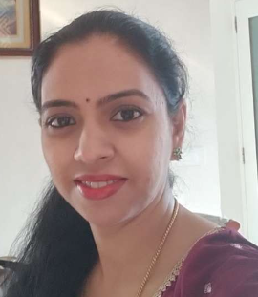


ACE PERFORMER
Her dedication and hard work is truly appreciated. Hard to be believe that she has been with us for less than 6 months ! She’s been racing to the No. 1 spot from the get-go.
Having her in the team makes a huge difference. All her team members respect her for being a kind, helpful, and skilled individual. With so much more to achieve, we wish her lots of success in the months and years ahead!
She delivers tangible results every month and AceNgage is truly proud to have her as a part of the Exits team. Keep Shining!
CHAYA RAMESH
Digital Certificate and
Gift voucher

Slide 3
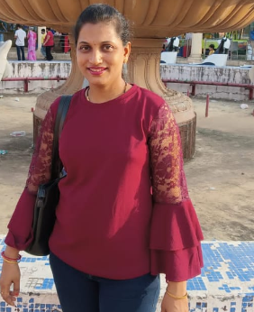
QUALITY PERFORMER
She is one of our senior member in the Elite Team and one of the first entrants to this special team. It’s truly amazing to see her consistent performance - whether it’s in adherence or quality.
No matter what the circumstances may be around her, she ensures that her daily and monthly numbers are achieved. She is an inspiration to many around her and we wish her continued success in the years ahead !
The commitment she brings to the table is something not to doubt at all. She has a long way to go. Shine on Always! Well deserved!
Quality – 84%
JYOTI K
Digital Certificate and
Gift voucher

Slide 4
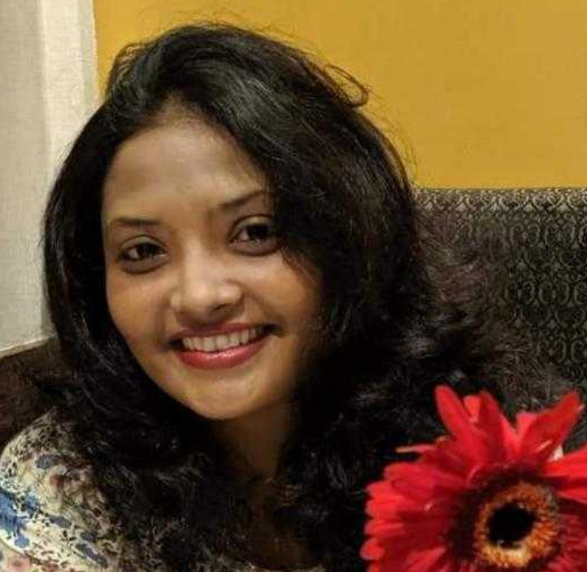
QUALITY PERFORMER
She is recognized for excellent performance and professionalism. She is highly committed and focused on the goals she sets for herself.
She is hardworking, responsible, and reliable, consistently delivering her best in everything she does. She is supportive and encouraging of those around her, always lending a helping hand when needed. She takes pride in her work and is always striving to improve and do her best.
Keep being the awesome Team Player that you are! Keep Shining!
Quality – 80%
VIDHI THAPAR
Digital Certificate and
Gift voucher

Slide 5
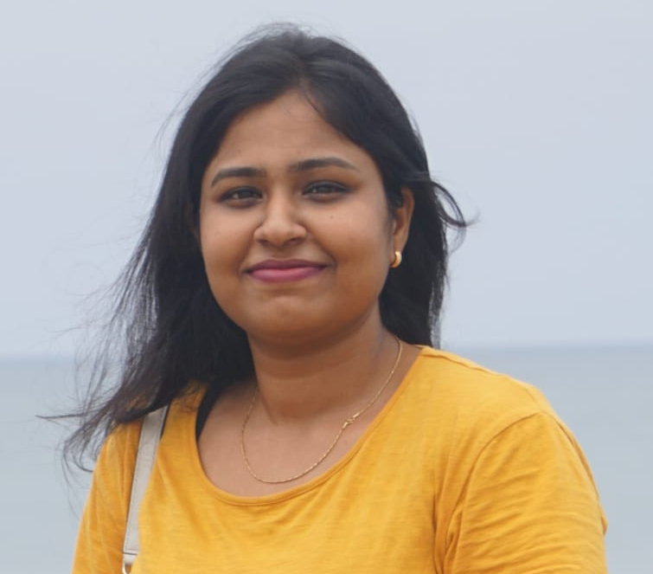
MOST IMPROVED PERFORMER
Her persistence and determination in completing your numbers helped us reach our targets much more quickly.
She has been a consistent performer in the company and the most impressive factor about her is her professionalism. She goes with the flow and has been a consistent performer when it comes to quality. For the past 1 year she has been achieving her targets frequently!
With hard work and dedication, she has moved up the curve and aims to rock it in future as well.
Thank you for an excellent job last month!
Good Job!
AKSHAYA K
Digital Certificate and
Gift voucher

Slide 6
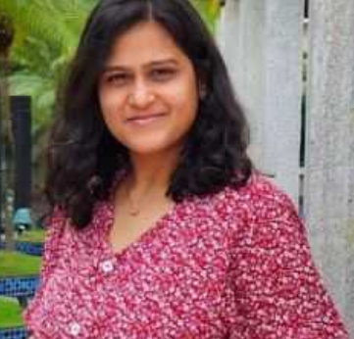
MOST IMPROVED PERFORMER
She is someone who delivers results through action. With a constant focus to be the best in your work, she has seen the most difficult days as a new joiner as she took time to improve.
But now she has scaled up and is racing to be No 1 with the other achievers in the group, She is always open to learning and implements feedback right away. This award is a recognition for her consistent efforts to grow and improve !
Keep up the spirit, Well Done and all the best for many more successes!
Good Job!
ANUSHREE B
Digital Certificate and
Gift voucher

Slide 7
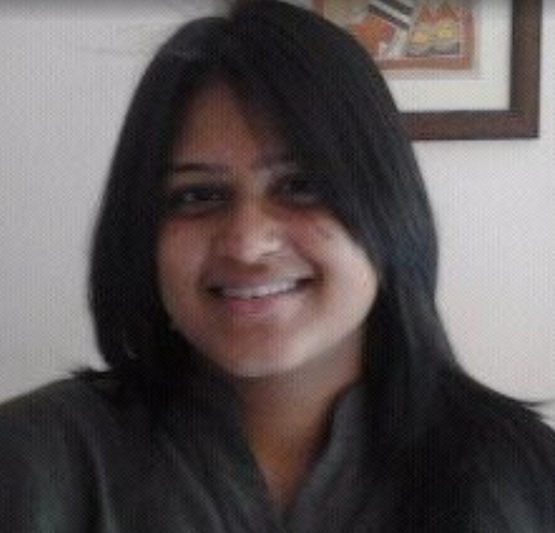
PAT ON THE BACK
She has been a steadying force in the team. Quietly and consistently working month on month to achiever her targets and keep her candidates and clients happy.
She is sharp, tenacious and a natural problem solver. We highly appreciate your hard work , commitment and dedication.
Thank you for your efforts !
Good Job indeed!
SHRADDHA WAGHMARE
Digital Certificate and
Gift voucher

Slide 8
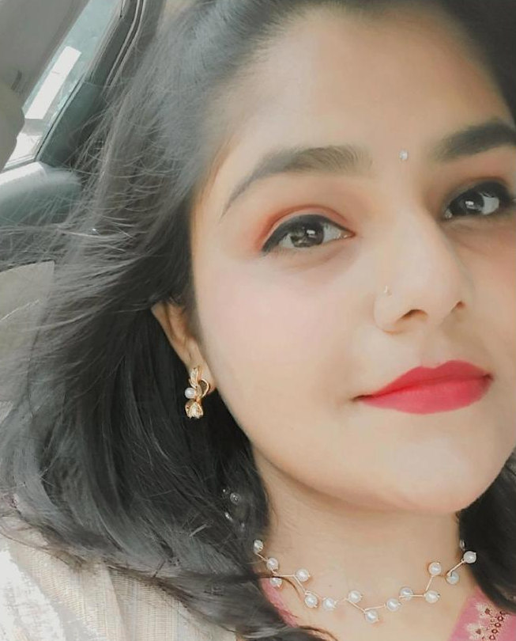
PAT ON THE BACK
She is a young woman who is driven and committed to putting in the effort required to achieve her goals. She is motivated, putting in the necessary time and effort to achieve what she wants from her work.
She is someone who always seeking new challenges and opportunities for growth. Her positive outlook and upbeat nature helps her overcome obstacles.
Her strong work ethic and positive attitude make her a valued member in our team.
We are proud of you for the work that you do!
SWATHI SHYAM
Digital Certificate and
Gift voucher

Slide 9
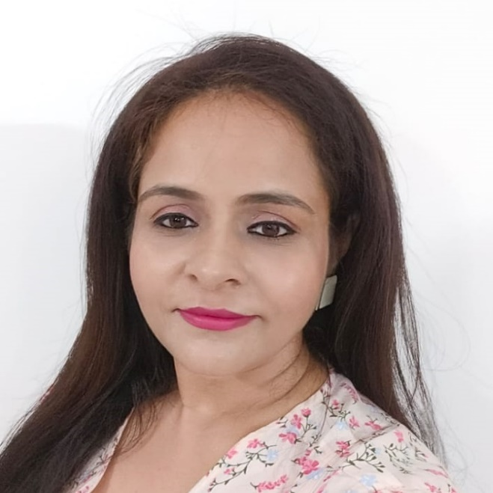
PAT ON THE BACK
She is a responsible, dedicated counsellor with strong determination who goes the extra mile to give her best.
Within just a couple of months in NHE , she is already making her mark in the team ! Her enthusiasm and dedication to the work is inspiring.
Her attention to detail is an asset to the team. She is a wonderful co-worker and it’s a joy to have her in the team.
She definitely deserve a pat on the back!
PUNIT CHANDOK
Digital Certificate and
Gift voucher

Slide 10
WINNERS LIST
CHAYA RAMESH
JYOTI K
VIDHI THAPAR
AKSHAYA K
ANUSHREE B
SHRADDHA WAGHMARE
SWATHI SHYAM
PUNIT CHANDOK

Slide 11
Well Done to the winners… – …Good Luck for Feb’23

